Slide 1
Country of the Day
The second largest country in South America (after Brazil).
An immigrant haven for Spanish, Italian, and German immigrants in the late 19th century.
30,000 people disappeared in a dirty war between 1976 and 1983.
Latin America’s biggest exporter of food—wheat, corn, oats, rye, sunflowers.
96% of their citizens are literate.
Argentina

Slide 2
Sample Topic: Refugee Children

Slide 3
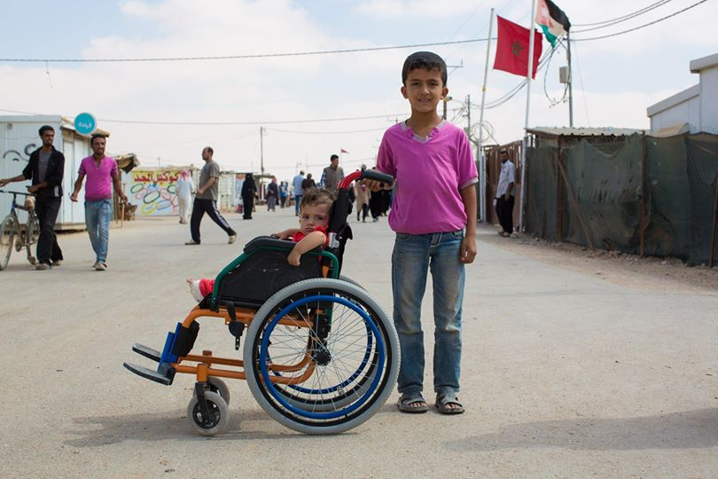
"What are your hopes for them?" "We left our hopes back in Syria." (Zaatari Refugee Camp, Jordan)

Slide 4
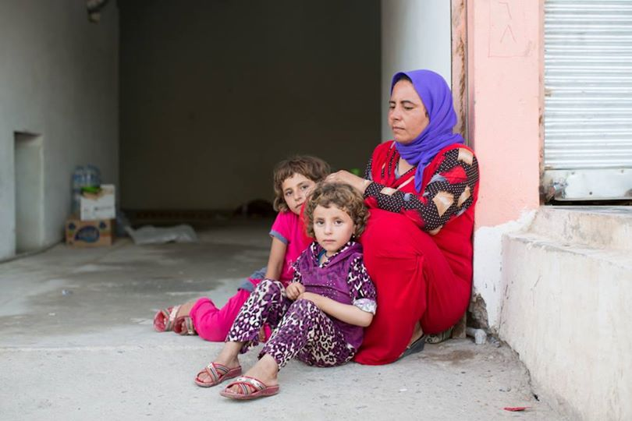
"All day they do is cry for home,“
(Dohuk, Iraq)

Slide 5
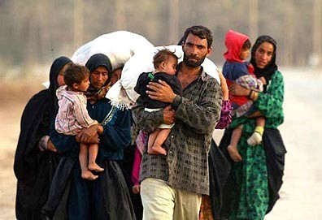
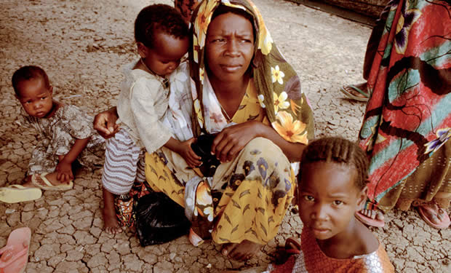
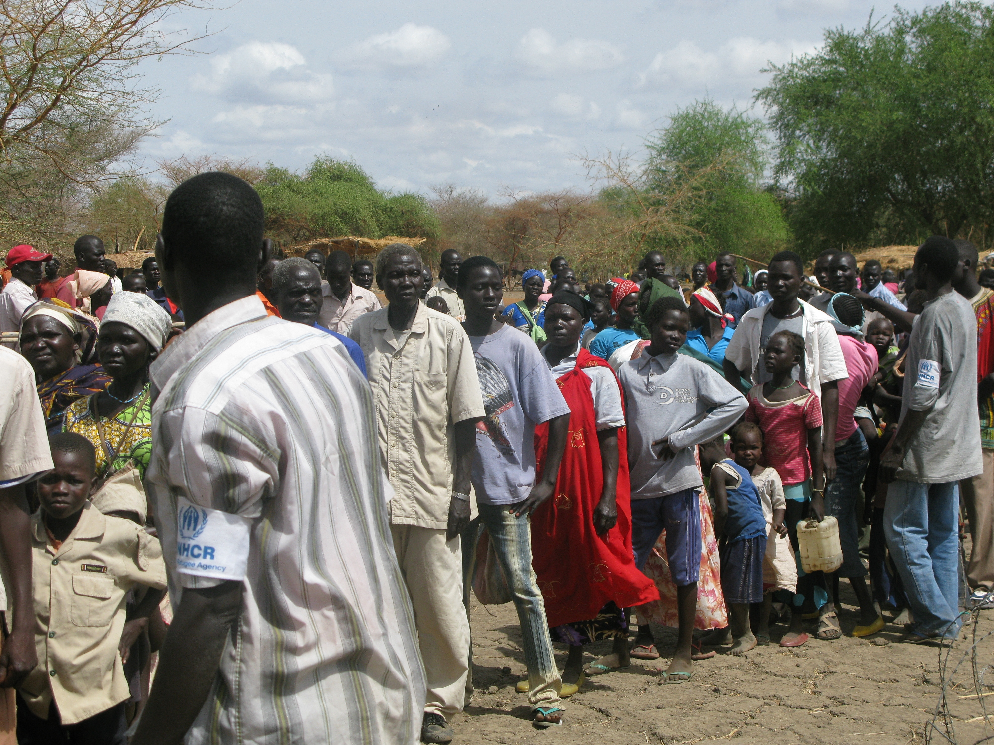
What are refugees?

Slide 6
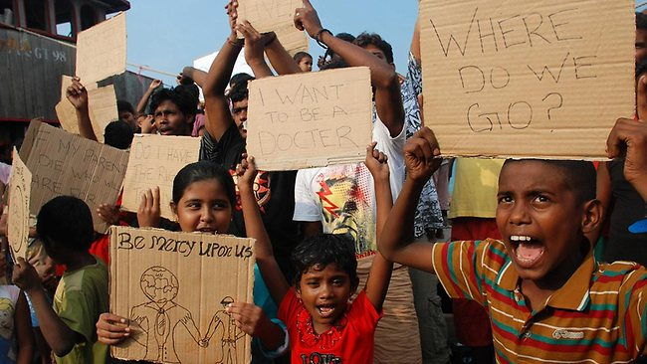
Refugees
Individuals who have been forced out of their homes and their countries due to conflict or natural disasters.
Refugees are very vulnerable and face challenges to their personal security, economic stability, and health.
The children of refugees are especially vulnerable.

Slide 7
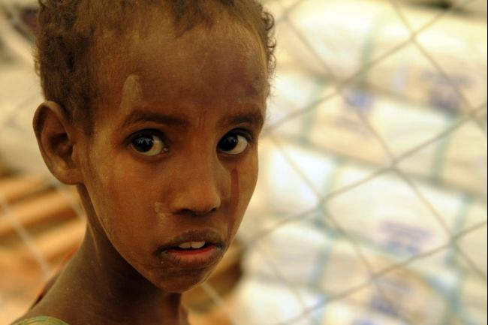
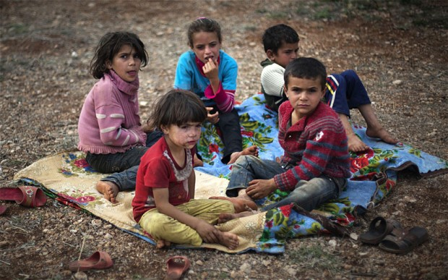
What problems do refugee children face?

Slide 8
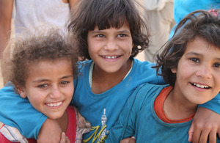
The absence of a family structure disrupts their sense of security
Need to be protected and educated.
Refugee children not only are deprived of a permanent home, but also of a stable lifestyle.

Slide 9
What is the problem we are tackling?
Many nations do not have plans or any resources devoted to the increasing number of refugees arriving in their countries. It is necessary for governments to set aside funds and resources to provide refugees with food, water, shelter, medical assistance and education.
Refugee children specifically need therapy and counseling to cope with the conflict and danger they experienced in their past.
The ultimate goal is to provide permanent shelter and a stable lifestyle to refugee children and their families.
Many organizations such as the United Nations Children’s Fund (UNICEF) exist to provide refugee children across the globe with basic necessities such as healthcare, nutrition, education, shelter, and emergency relief.

Slide 10
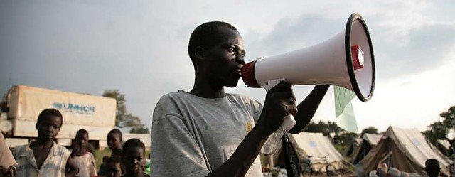
Previous Action
United Nations High Commissioner for Refugees (UNHCR)--1950.
UNHCR Policy on Refugee Children was established in 1993.
Donations and suggestions from the United Nations and third party organizations fund resettlement and reintegration programs.
The UNHCR helps migrants that leave their homeland because of persecution, armed conflict and national disaster.

Slide 11
Future Action?
Protection. It is necessary to provide refugee children with food, water, and medical attention. It is also imperative that they receive therapy to subdue the psychological effects of a difficult childhood. How can we make sure that there are adequate supplies for all refugees? In what ways can we alleviate post-traumatic stress in young children?
Aid. Children must receive medical attention. They must be educated regarding primary subjects. Do refugee children have access to social services? Are the teachers, medical staff and program directors trained to support children with severe distress?
Reintegration. Refugee children should be reintegrated back into society after receiving aid and education so they can become independent and self-sufficient. There must be facilities assisting with relapse and distress to aid former refugees as well. How can we encourage former refugee children to further their education or continue with vocational training? What opportunities can we provide for refugees for jobs, shelter, recreation, and other areas?

Slide 12
This is what a Model UN session would work towards

Slide 13
First Step: Assignment for Wednesday
DUE ON WEDNESDAY, OCTOBER 15
Work with partner to research your given country
Fill out country sheet (both of you should hand in separate country sheets, even though you can share information)
On back of country sheet, write down some information that you found about your country specifically regarding refugee children.

Slide 14
United States
Mexico
Poland
Libya
Uzbekistan
Haiti
United Kingdom
Chad
Germany
Vietnam
Greece
South Africa
New Zealand

Slide 15
Possible Resources
UNHCR: http://www.unhcr.org/cgi-bin/texis/vtx/home
UNHCR's policy and guidelines on refugee children: http://www.unhcr.org/3ae68bf60.html
UNICEF – Refugee children, guidelines on protection and care: http://www.unicef.org/violencestudy/pdf/refugee_children_guidelines_on_protection_and_care.pdf
Convention on the Rights of the Child: http://www.crin.org/resources/treaties/CRC.asp?catName=International+Treatie
Go to website for more possible resources

Slide 16
ANY QUESTIONS?

Slide 19
The absence of a family structure disrupts their sense of security
Need to be protected and educated.
Refugee children not only are deprived of a permanent home, but also of a stable lifestyle.

Slide 20
absence of family structure disrupts sense of security
protected and educated.
deprived of stable lifestyle.

Slide 21
What is the problem we are tackling?
Many nations do not have plans or any resources devoted to the increasing number of refugees arriving in their countries. It is necessary for governments to set aside funds and resources to provide refugees with food, water, shelter, medical assistance and education.
Refugee children specifically need therapy and counseling to cope with the conflict and danger they experienced in their past.
The ultimate goal is to provide permanent shelter and a stable lifestyle to refugee children and their families.
Many organizations such as the United Nations Children’s Fund (UNICEF) exist to provide refugee children across the globe with basic necessities such as healthcare, nutrition, education, shelter, and emergency relief.

Slide 22
Problem?
Many nations don’t have plans or any resources devoted. Must set aside funds for food, water, shelter, medical assistance and education.
Kids need therapy and counseling to cope with conflict
ultimate goal→provide permanent shelter and stable lifestyle
Organizations like UNICEF provide refugee kids with basic necessities

