Slide 1
HOW TO RESEARCH
Elena Ayala-Hurtado

Slide 2
What is Research?
“The systematic investigation into and study of materials and sources in order to establish facts and reach new conclusions”
By looking into other people’s work, we can learn and bring different ideas into conversation.
This is essential to the progression of the world’s knowledge.

Slide 3
When might using the Internet be better than using a Book?
Topics that are contemporary (modern topics) – The Internet has more up-to-date information on current events.
Topics that are controversial – The Internet can give you a lot of different opinions on one topic. It can help you research a topic from different perspectives.

Slide 4
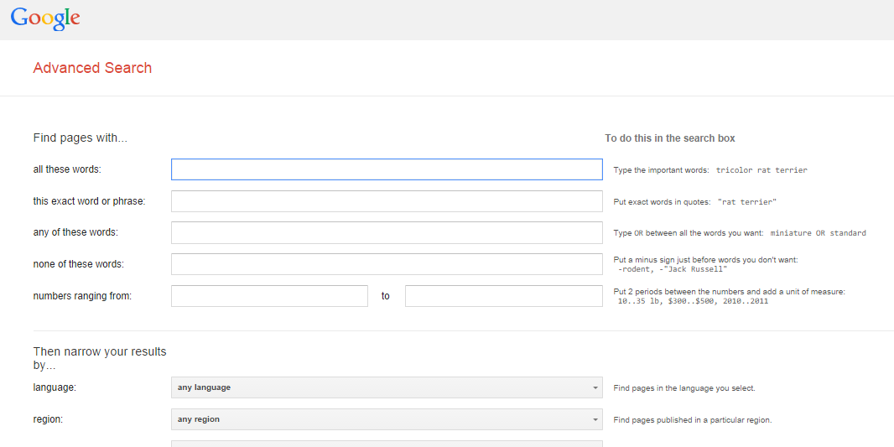
How to search
Make use of Advanced search

Slide 5
How to search
Ask good questions
Don’t search for “Abraham Lincoln” if you only want to know about his assassination. How would you search for that?
Use AND, OR and other advanced search tools.
Continue searching—this takes time, and as you find information, it’ll lead you in more directions!!
History
Immigration in the United States
Mexican Immigration in the United States
Mexican Perception
American Reception

Slide 6
Reliability

Slide 7
But Wikipedia isn’t the only bad source

Slide 8
Reliable sources: questions to ask
Who is the author(s)? What are their credentials?
Who is making the information available? How is the site being funded? Do they have political leanings or other biases? Are they writing facts, or their opinions?
The “About Us” section of a site is a good place to start but it shouldn’t be the end of your research
When was the information first published? Has it been updated recently?
Very important if you’re discussing current events or politics!!

Slide 9
Once you have your (reliable) sources
- SCAN the information for key words or phrases. DO NOT try and read everything - it's too much. - Underline, highlight, or take notes on the IMPORTANT information. - LOOK UP new vocabulary that you don't recognize.

Slide 10
Once you have your (reliable) sources
- CITE your sources. Save websites and articles so you can find them again later. - THINK!!! While reading, CONNECT ideas. - WORK HARD! Research is the basis for all future work.

Slide 11
IN-Class assignment
Read the article that you have been assigned.
Highlight and underline important information as you go along
Answer the comprehension questions in your own words. For the last question, answer in two or three sentences.
On the back of the page, write down the most important things you have learned and some key words related to the topic. Also write down vocabulary words you don’t understand.
When you’re finished, share the information you have learned with people who have read a different article from you.

Slide 12
Take-Home assignment
Due tomorrow in class.
Look up any words that you did not understand from your article.
These articles are from a couple of weeks ago. Do some research tonight and see if there have been any more updates on these topics.
Tomorrow we will ask you to hand in:
Your completed comprehension questions.
The article should be highlighted or underlined; vocab words and key facts should be on the back of the sheet.
A two or three sentence summary of the topic update, with at least one citation.
You may be asked to share what you’ve learned with the class.

