Slide 1
Gender and Resolutions:
Educations, Policies, and Gender Roles

Slide 2
(Some) Unwritten Rules in Society
Men should be the heads of the household. They should make more money for the family and serve as authority figures.
Women should be more affectionate. They should take care of the children and cook for their families.
Men should not be emotional. They should not cry. They should be less affectionate, especially with each other.
Women should not be “bossy.”
Guys should ask girls out and pay for the dates.
Girls are not as smart at math or science.

Slide 3
What is feminism??
Do you consider yourself a feminist?

Slide 4
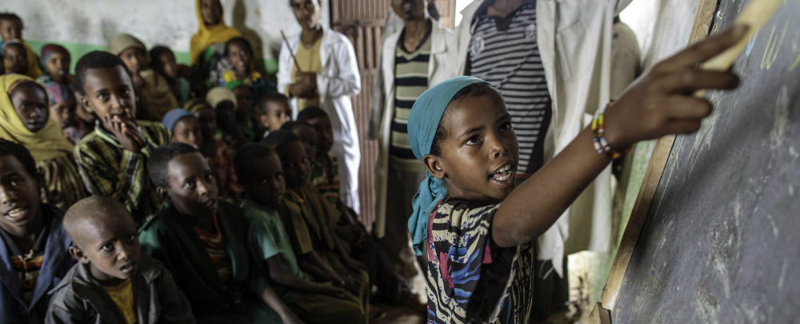
1. Education
Education is not always equally available for girls and boys.
According to the Millenium Goals, there has been an achievement of equality in primary education between girls and boys, but not further
There are many countries in which education for girls is not considered as important.
There are many organizations that work to make it more likely for girls to stay in school
UNICEF helped introducea girls’ re-entry policy in South Africa and Zambia that allows girls to return to school following childbirth.
United Nations Girls’ Education Initiative (UNGEI)—in Chad, there is a project called the Female Education Promotion Project that targets girls and women. It supports the training of teachers, audio-visual programs and theatre that is pro-girls’ education, and helps mothers learn by arraging daycare for children between 3 and 5 years old.

Slide 5
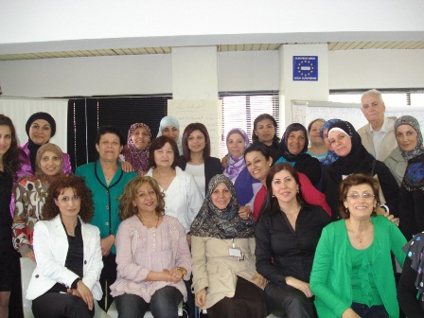
Education for Adults
Just as girls need to be educated—taught to read, to write, to think….so do older women
Even women who are literate need to be taught to be leaders.
In Haiti, the UN mission MINUSTAH organized workshops to advance the level of women’s participation in leadership positions
Help women build confidence and learn how important their participation is.

Slide 6
2. Policies http://www.bbc.com/news/world-30047618
Quotas—a certain number of women must be included
Can be a quota for a candidate list—minimum percentage must be women.
Uruguay requires political parties to include women on their electoral lists at all levels--as primary candidates and alternates, as candidates for both chambers of the country's legislature, departmental assemblies, local assemblies, mayoral posts, election boards and within all political parties' internal leadership.
Reserved seats among representatives—certain number must be women
In Uganda 56 seats, one for each district, are reserved for women.
In Rwanda, 30% of the seats are for women (written in the constitution)
Voluntary Party Quotas—not enforced by laws, but parties commit to having a quota for women.
Quotas are aimed at making sure that women constitute at least a “critical minority--30-40%

Slide 7
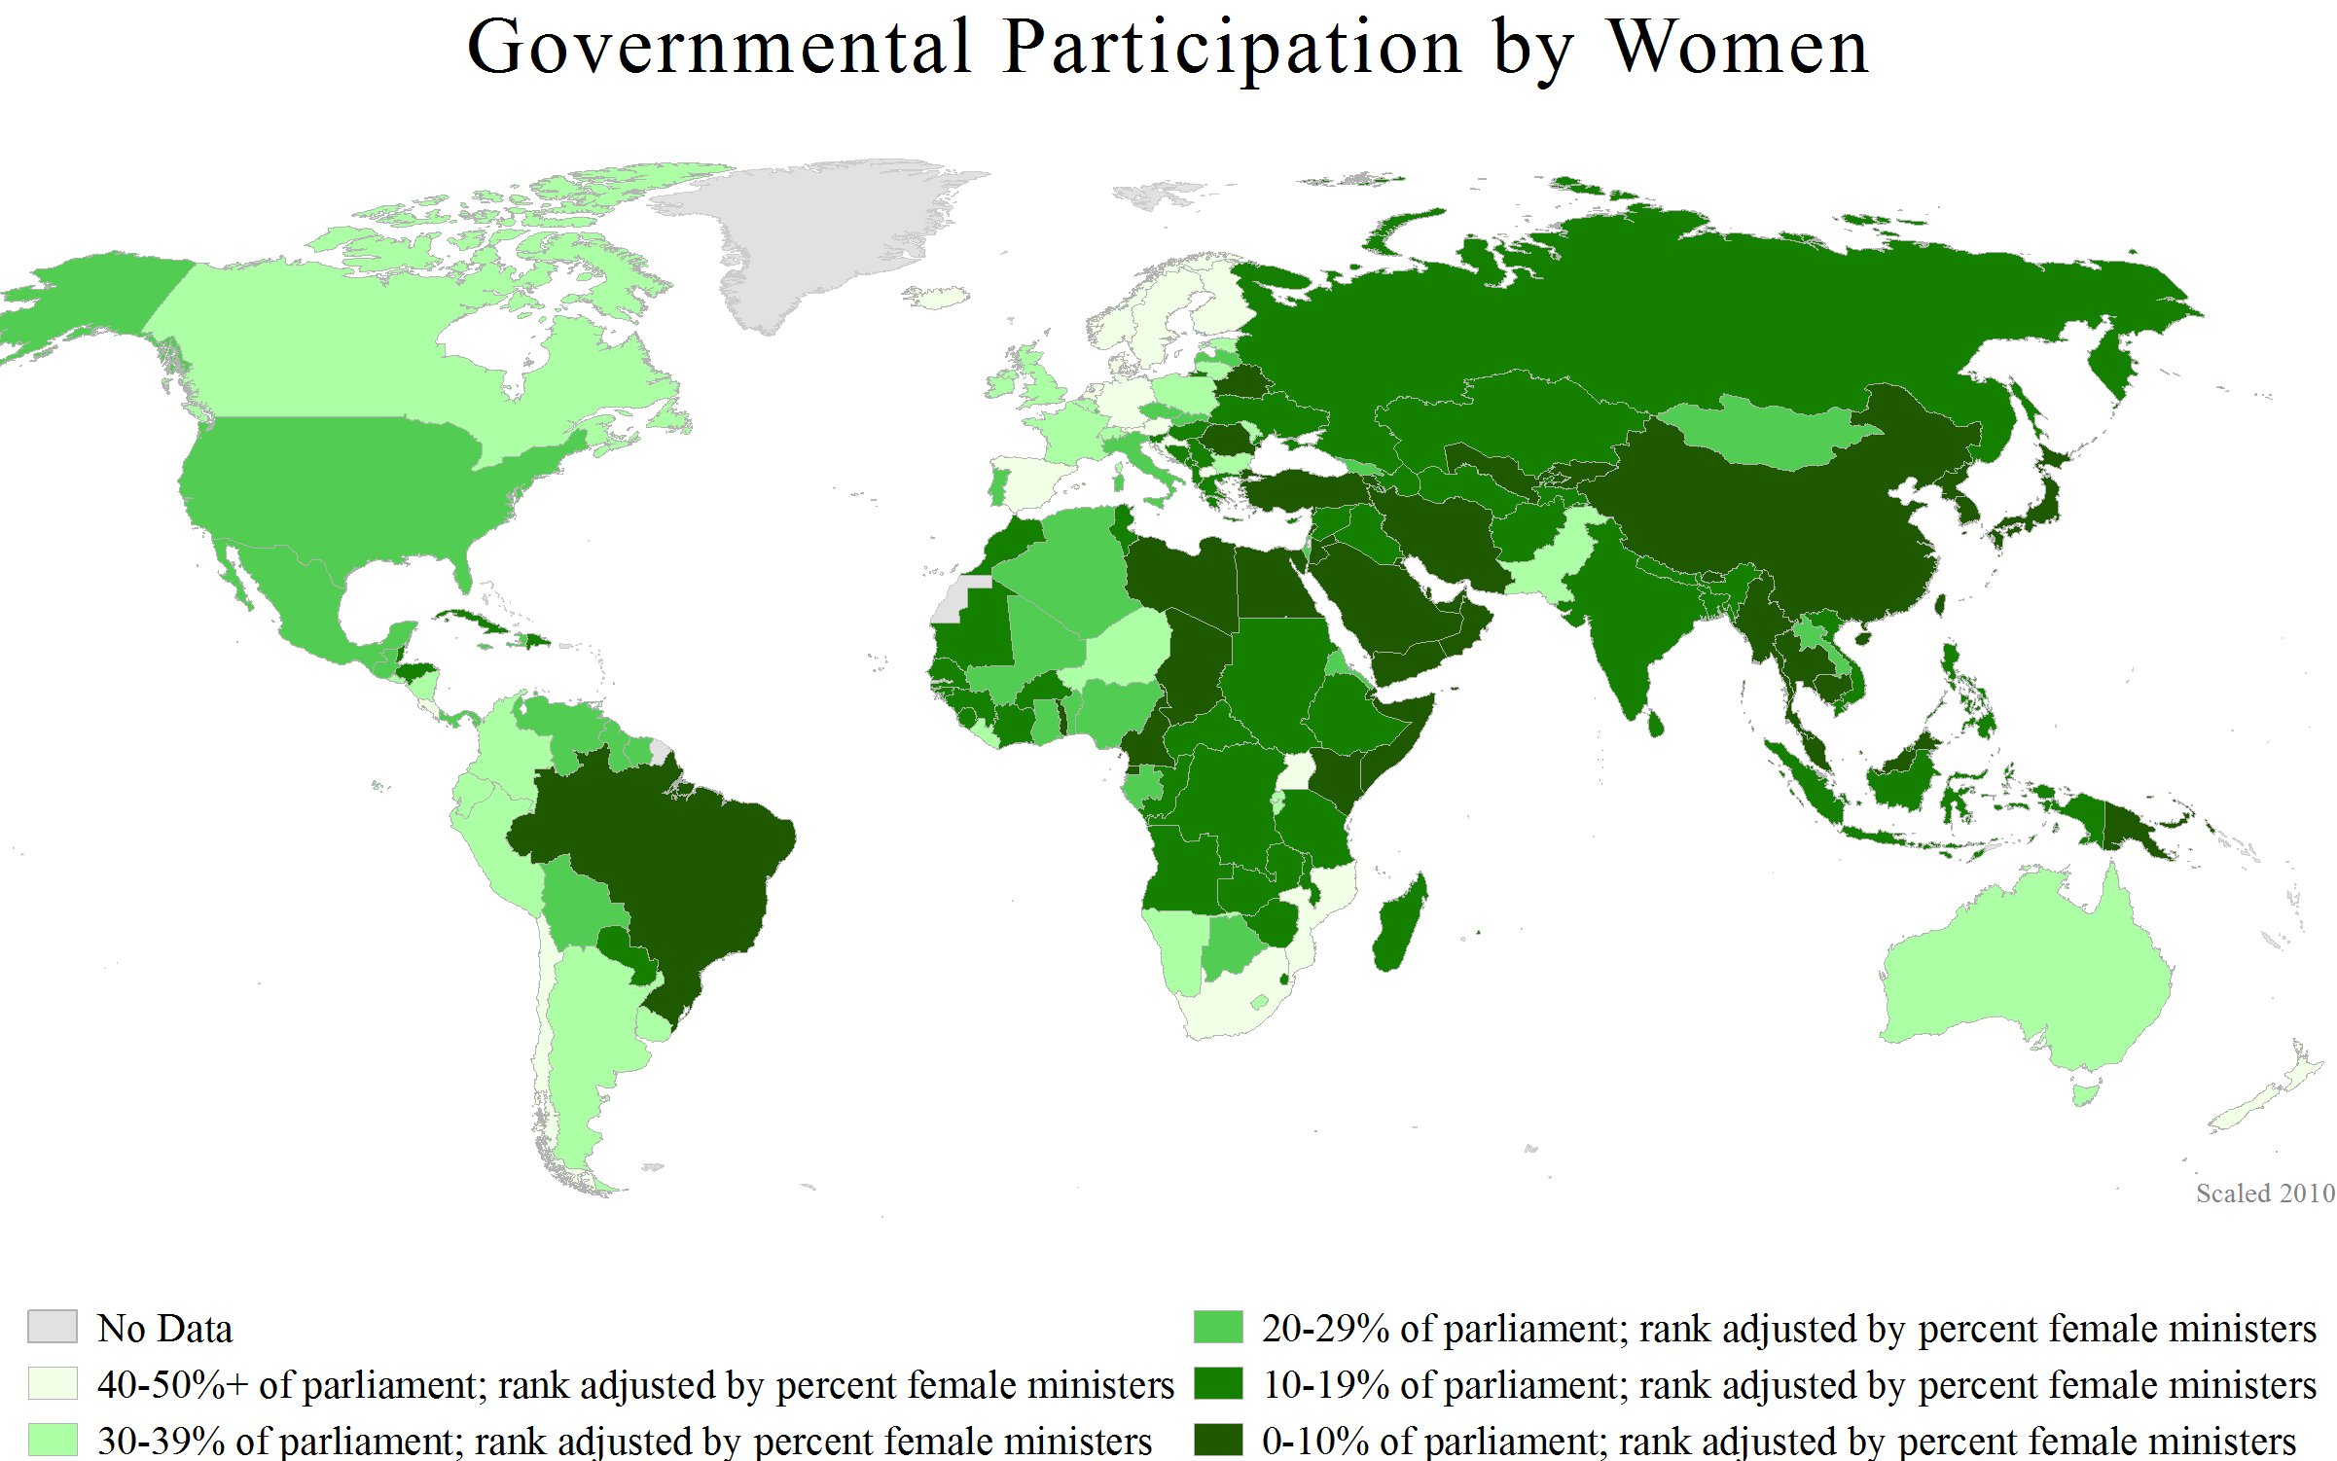
Why are quotas controversial?
Quotas are a fast way to work towards equality that might otherwise take centuries, but they are not universally loved.
Are quotas equal? Are quotas fair?
Do quotas prevent voters from deciding who is elected?

Slide 8
Why are women underrepresented to begin with?

Slide 9
3. Gender Roles
Gender roles are underneath everything else we have talked about
In the global survey of parliamentarians conducted by the Inter-Parliamentary Union in 2008, women parliamentarians identified the following factors as the most significant obstacles in pursuing successful political careers
Domestic responsibilities
Prevailing cultural attitudes regarding the roles of women in society
Lack of support from the family
Lack of confidence
Lack of finances
Lack of support from political parties
Each and every one of these problems is related to the gender norms and gender roles that women are expected to play and the reactions that different people have to their roles.

Slide 10
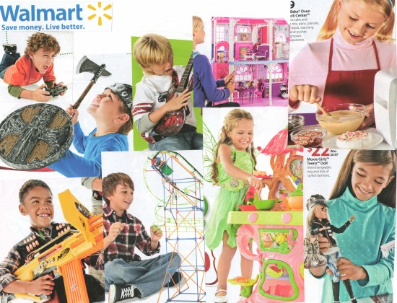
Gender Roles
Gender roles cause problems even for women who aren’t directly related to government—women who just need the right to vote and participate locally.
In some countries, women are expected to stay in the home and are either not allowed to vote or are discouraged for voting due to cultural norms
How do we change gender norms?
(Individually) be the role model for people around you
Early childhood education programs
Education programs in general
Advertisement campaigns

Slide 11
More Information on Quotas
http://www.idea.int/publications/wip2/upload/4-_Increasing_Womens_Political_Representation.pdf
http://www.idea.int/publications/atlas-of-electoral-gender-quotas/upload/Atlas-on-Electoral-Gender-Quotas_3.pdf

